Slide 1


INVESTIGATING THE DEPENDENCE ON MACHINE SIZE OF THE ENERGY CONFINEMENT IN TOKAMAKS USING DATA-DRIVEN METHODS
European Master of Science in Nuclear Fusion and Engineering Physics
M.Sc. Student Karina Chiñas Fuentes
Prof. Dr. Geert Verdoolaege
PhD Student Joseph Hall
11/07/2023
Notes:
title

Slide 2
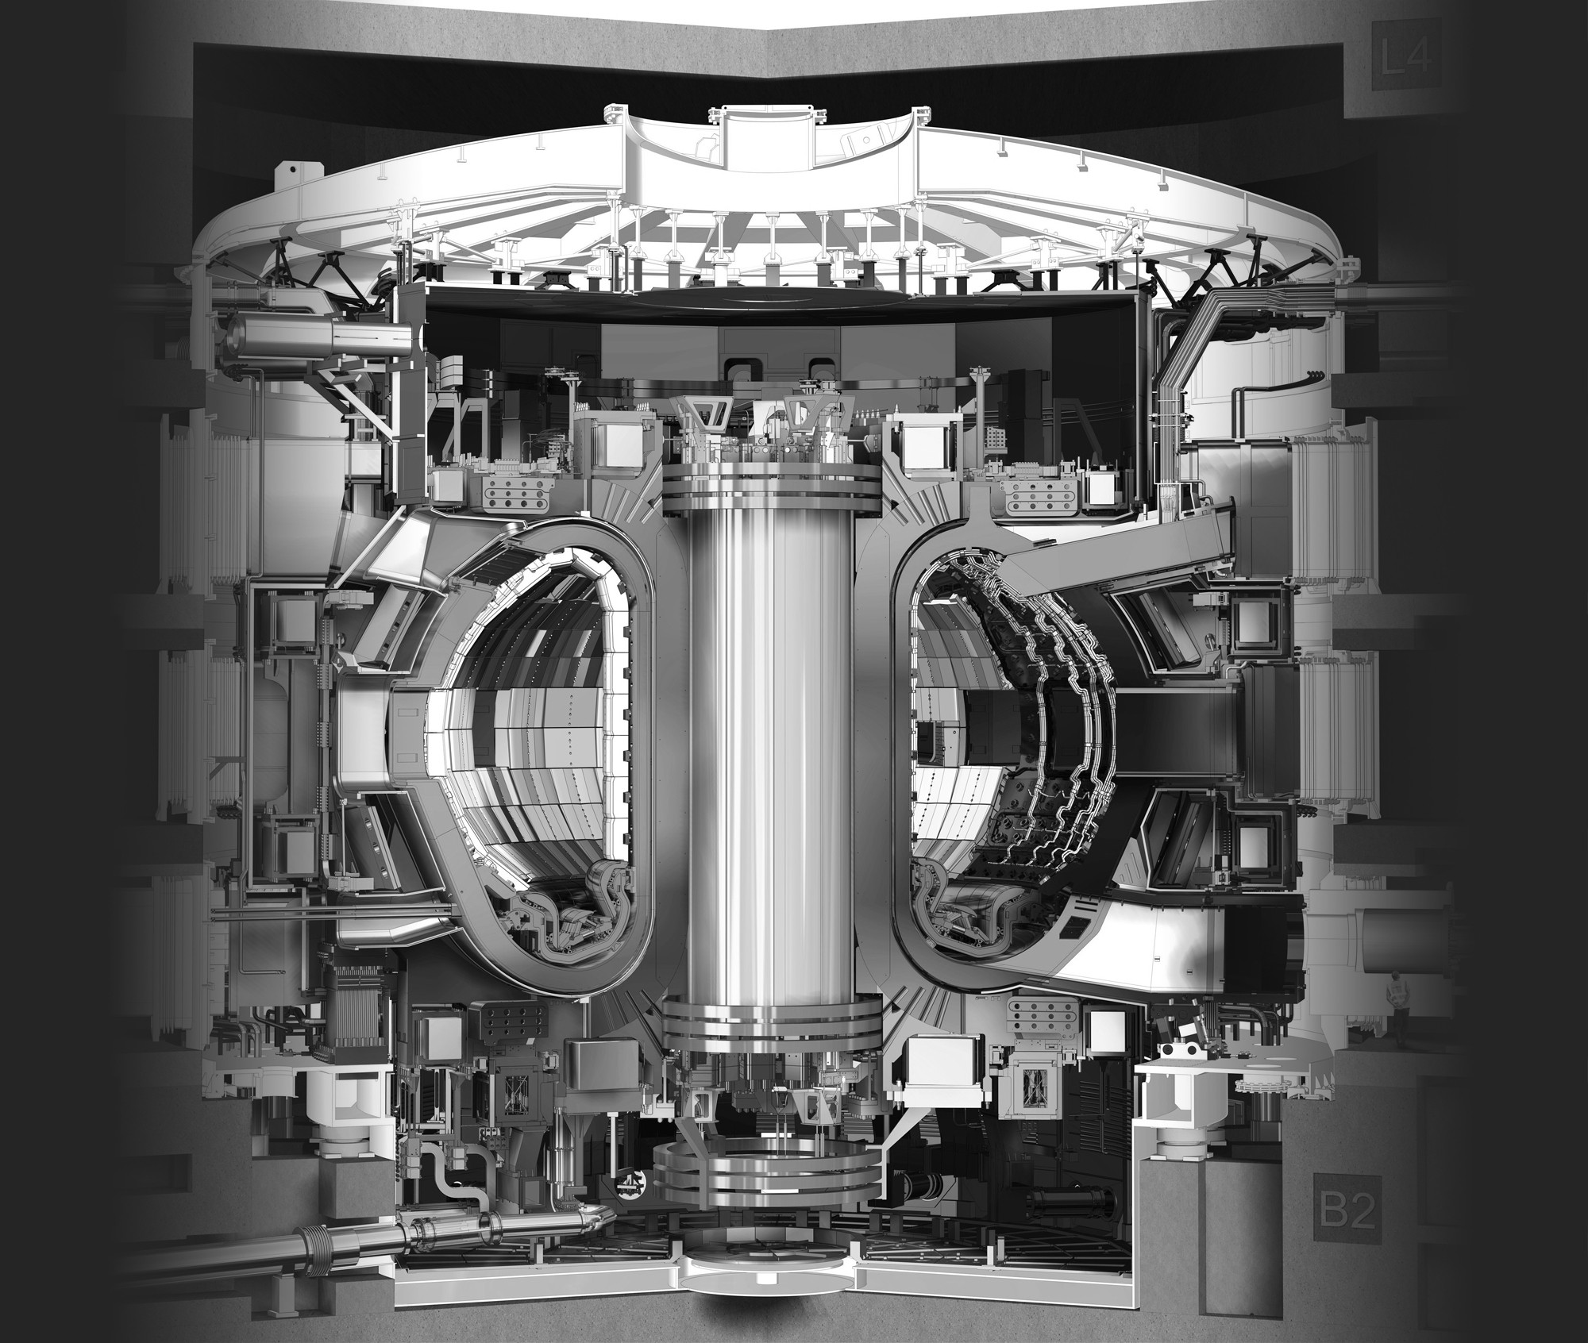
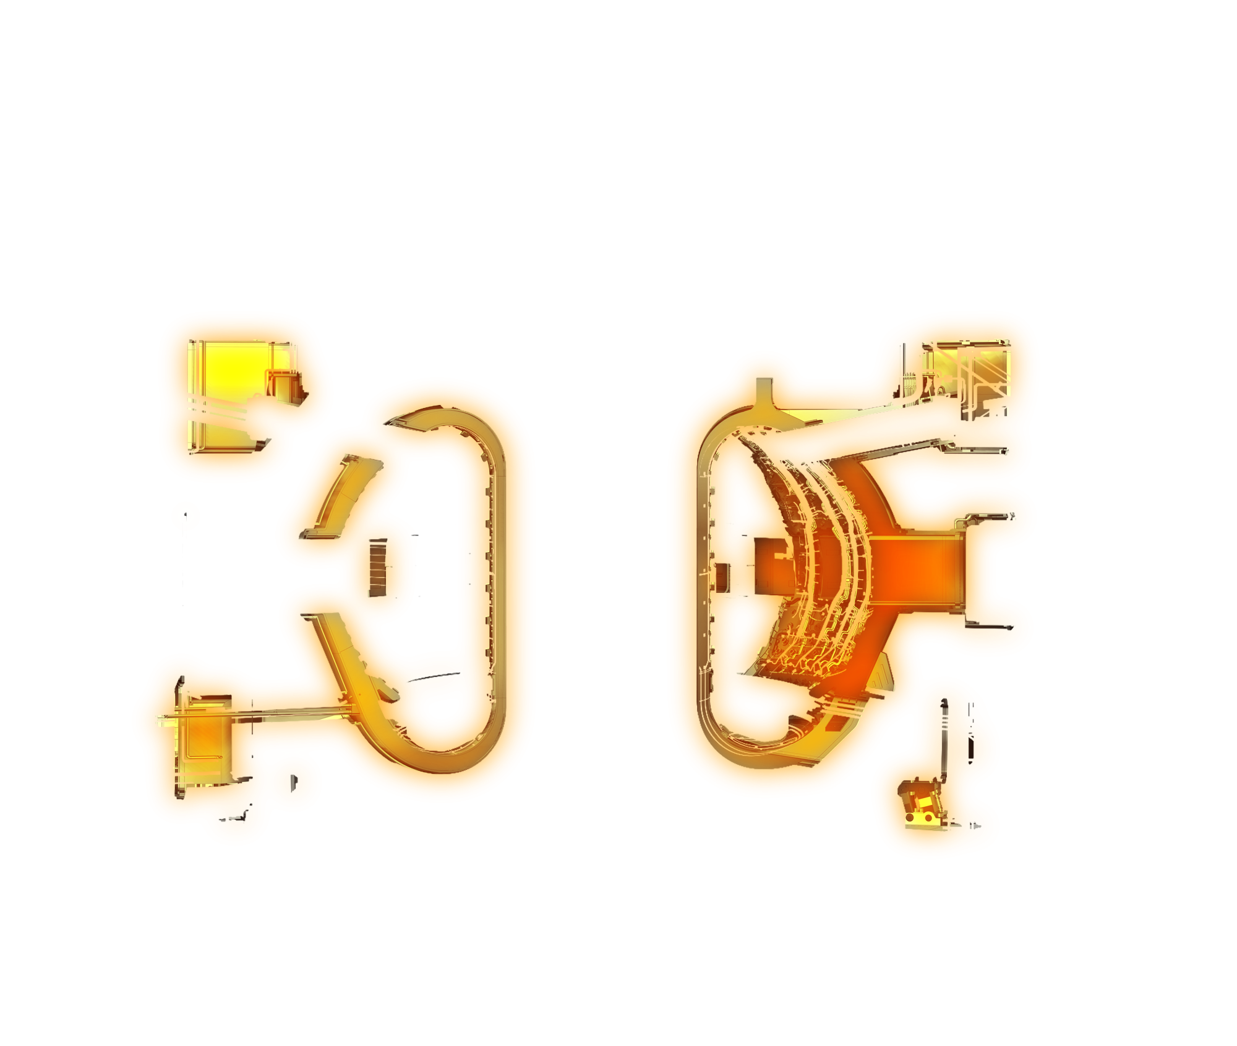
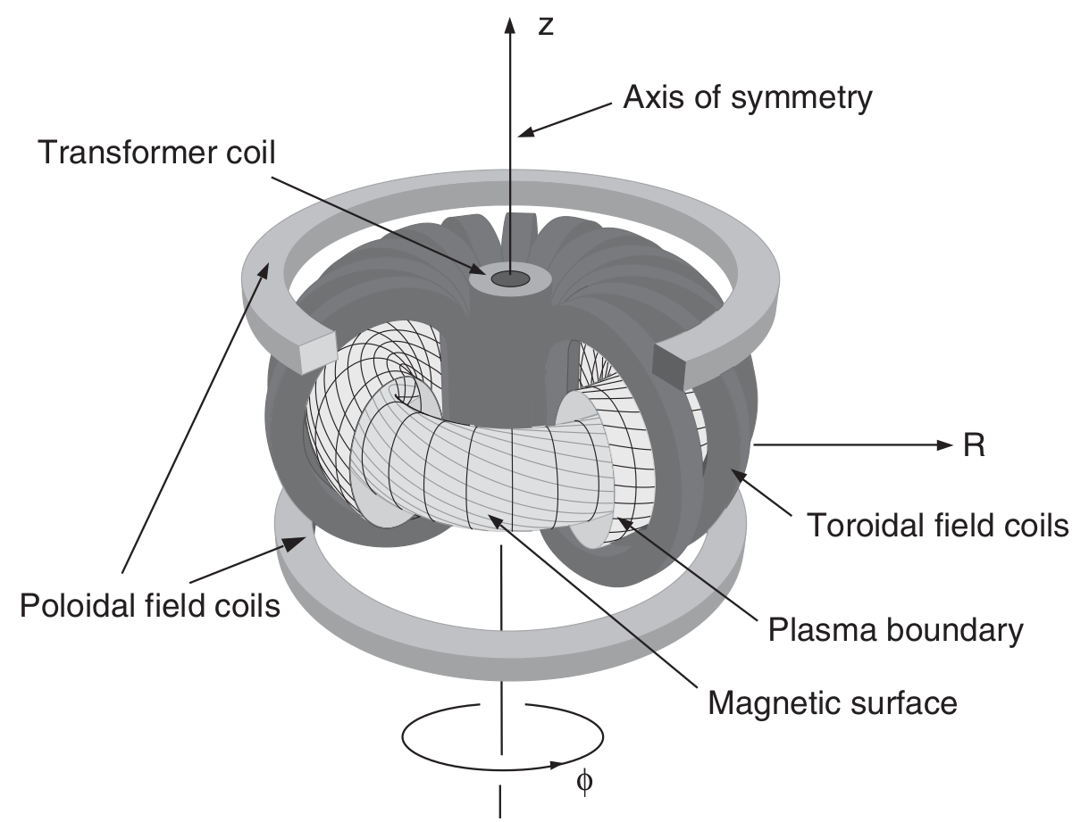
European Master of Science in Nuclear Fusion and Engineering Physics
TOKAMAKS
[ITER Organization, 2023]
log(τ_{E,th})
OLS
[Hartmut Zohm, 2015]
Notes:
Induced net toroildal plasma current through the transformer coil.

Slide 3
European Master of Science in Nuclear Fusion and Engineering Physics
H-mode (EMLy subset) confinement database
TOKAMAKS
STDB2
1998
STDB5
2021
WHY?
α_{R} ~ 2.22
α_{R} ~ 1.45
DATA?
PHYSICS?
WHAT CAN WE LEARN?
[Hartmut Zohm, 2015]
Notes:
Is the reason of this decrease due to data-related issues?
Or does it has to do with smt of the Physics going on inside the TOKAMAK?
What can we learn from this phenomenon / Event?

Slide 4
European Master of Science in Nuclear Fusion and Engineering Physics
WORKFLOW
WHICH REGISTERS IN STDB5 ARE DECREASING α_{R}?
IS THIS DECREASE DUE TO
DATA ISSUES?
CAN WE PREDICT WHETHER A NEW REGISTER WILL DECREASE α_{R}?
RELATE THE FINDINGS TOKAMAK CHARs & PHYSICS
Notes:
This will allow to not only tell “here are your responsible observations” but hopefully

Slide 5
European Master of Science in Nuclear Fusion and Engineering Physics
WORKFLOW
WHICH REGISTERS IN STDB5 ARE DECREASING α_{R}?
IS THIS DECREASE DUE TO
DATA ISSUES?
CAN WE PREDICT WHETHER A NEW REGISTER WILL DECREASE α_{R}?
RELATE THE FINDINGS TOKAMAK CHARs & PHYSICS
Notes:
title

Slide 6
European Master of Science in Nuclear Fusion and Engineering Physics
FINDING THE DECREASING REGISTERS
STDB2
‘82 - ’97
STDB5
1982 - 2017
Dataset size = 6252

Slide 7
European Master of Science in Nuclear Fusion and Engineering Physics
FINDING THE DECREASING REGISTERS
STDB2
New STDB5
‘82 - ’97
1989 - 2017
Dataset size = 1310
UNAFFECTING
Dataset size = 4942

Slide 8
European Master of Science in Nuclear Fusion and Engineering Physics
FINDING THE DECREASING REGISTERS
Increase
OLS
α_{R}
Plot
Decrease
STDB2
New STDB5
‘82 - ’97
Save in new dataset
1989 - 2017

Slide 9
European Master of Science in Nuclear Fusion and Engineering Physics
FINDING THE DECREASING REGISTERS
Increase
OLS
α_{R}
Plot
Decrease
STDB2
New STDB5
‘82 - ’97
Save in new dataset
1989 - 2017

Slide 10
European Master of Science in Nuclear Fusion and Engineering Physics
FINDING THE DECREASING REGISTERS
Increase
OLS
α_{R}
Plot
Decrease
STDB2
New STDB5
‘82 - ’97
Save in new dataset
1989 - 2017

Slide 11
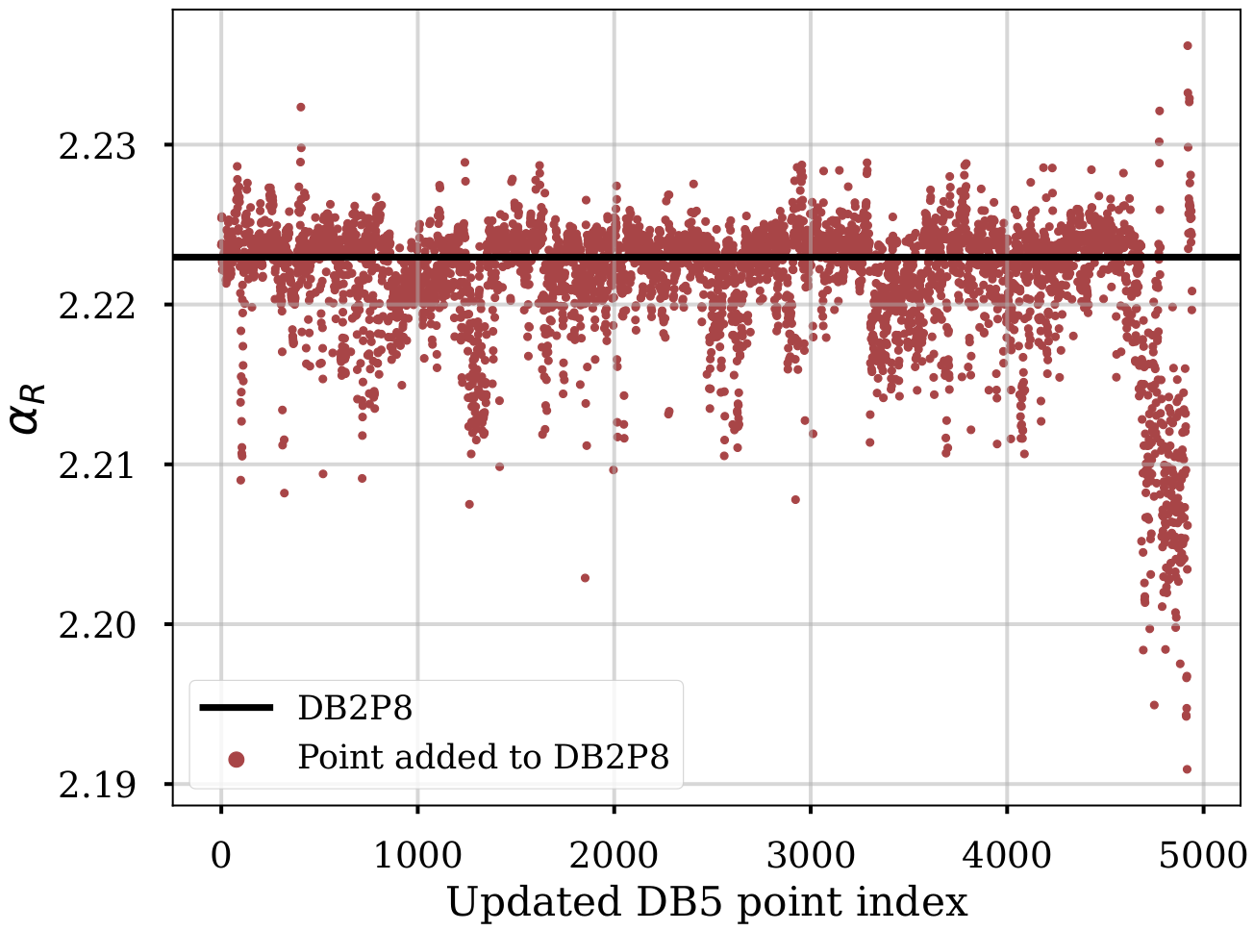
European Master of Science in Nuclear Fusion and Engineering Physics
DECREASING REGISTERS
Plot
New STDB5
Random Sampling
1989 - 2017
New STDB5 register index
Notes:
I will do random sampling of the individual decreasing observations.

Slide 12
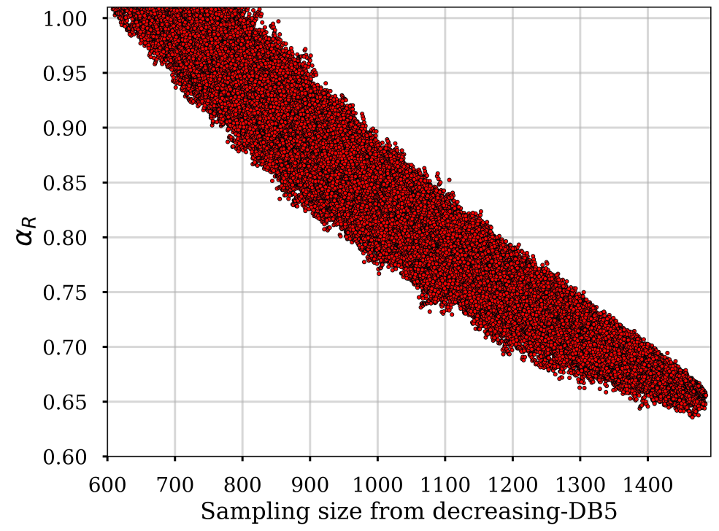
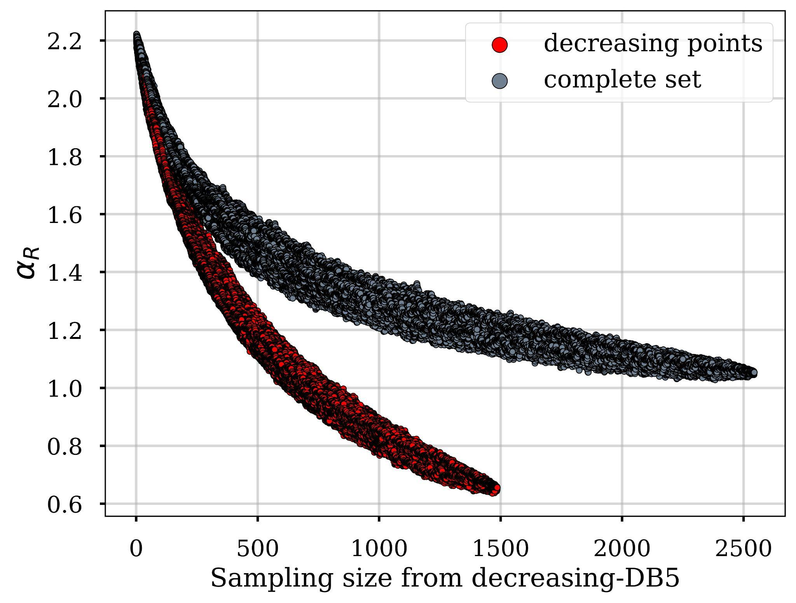
European Master of Science in Nuclear Fusion and Engineering Physics
DECREASING REGISTERS
Decreasing New STDB5 register index
Decreasing New STDB5 register index

Slide 13
European Master of Science in Nuclear Fusion and Engineering Physics
DECREASING REGISTERS
“Small dataset”
“Big dataset”
Smallest subset for α_{R} < 1
α_{R} ~ 0.9998
Subset size = 618
Smallest α_{R}
α_{R} ~ 0.6379
Subset size = 1459
Random Sampling
OLS
9.88% decreased α_{R}
90.12% did not
23.34% decreased α_{R}
76.66% did not
STDB2
New STDB5 register index
STDB5

Slide 14
European Master of Science in Nuclear Fusion and Engineering Physics
DECREASING AND UNAFFECTING REGISTERS
“Small dataset”
“Small dataset”
“Big dataset”
“Big dataset”
Smallest subset for α_{R} < 1
α_{R} ~ 0.99
dataset size = 618
Complementary for α_{R} < 1
α_{R} ~ 1.71
dataset size = 5634
Complementary for smallest α_{R}
α_{R} ~ 2.16
dataset size = 4793
Smallest α_{R}
α_{R} ~ 0.64
dataset size = 1459
Together they make STDB5
+
+
dataset size = 6252

Slide 15
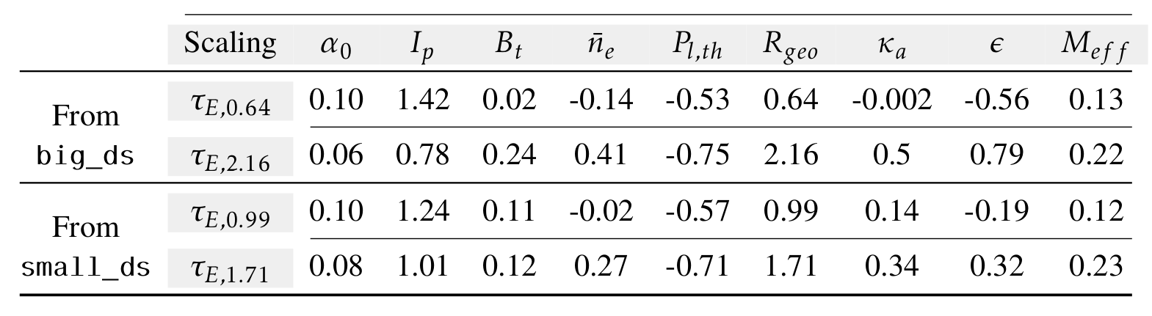
European Master of Science in Nuclear Fusion and Engineering Physics
DECREASING AND UNAFFECTING REGISTERS
Decr.
Unaff.
Decr.
Unaff.

Slide 16
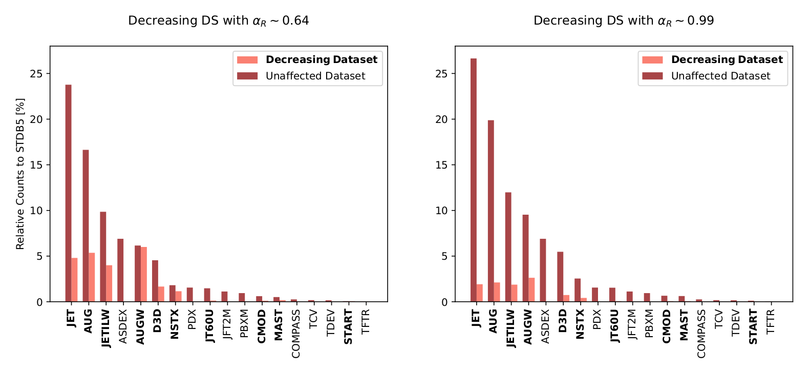
European Master of Science in Nuclear Fusion and Engineering Physics

Slide 17
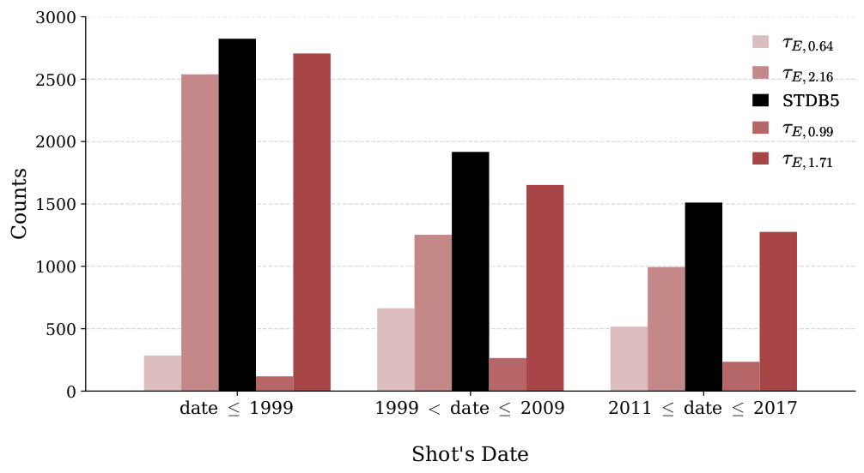
European Master of Science in Nuclear Fusion and Engineering Physics

Slide 18
European Master of Science in Nuclear Fusion and Engineering Physics
WORKFLOW
WHICH REGISTERS IN STDB5 ARE DECREASING α_{R}?
IS THIS DECREASE DUE TO
DATA ISSUES?
CAN WE PREDICT WHETHER A NEW REGISTER WILL DECREASE α_{R}?
RELATE THE FINDINGS TOKAMAK CHARs & PHYSICS
Depends on how you classify / label them.
Notes:
title

Slide 19
European Master of Science in Nuclear Fusion and Engineering Physics
Used as predictors for the target
MULTICOLLINEARITY?
Features / Variables
CONSEQUENCES
Increase in the standard errors of each feature
Numerical instability
Unreliable models
I_{p} [MA] | B_{t} [T] | …. | ϵ | τ_{E,th} [s]
0.2959 | 2.205 | …. | 0.242 | 0.051
…. | …. | …. | …. | ….
0.9794 | 4.795 | …. | 0.327 | 0.1731
0.3740 | 1.744 | …. | 0.286 | 0.0340
VIF
Condition Index
VD
Variance Inflation Factor
Variance Decomposition
[W.-M Lee, 2021]
[D.Besley, E. Kuh, and R. Welsch, 2004]
[R. M. O’Brien, 2007]
Notes:
“Multicollinearity is a special case of collinearity where a feature exhibits a linear relationship with two or more features.”

Slide 20
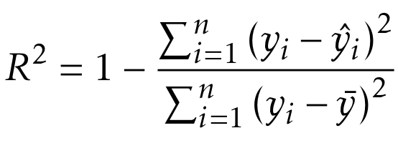
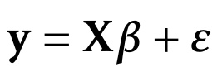
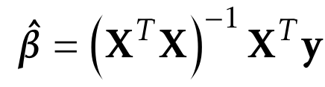
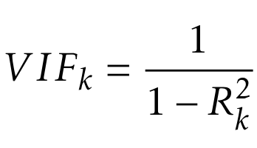
European Master of Science in Nuclear Fusion and Engineering Physics
VARIANCE INFLATION FACTOR
I_{p} [MA] | B_{t} [T] | …. | ϵ | τ_{E,th} [s]
0.2959 | 2.205 | …. | 0.242 | 0.051
…. | …. | …. | …. | ….
0.9794 | 4.795 | …. | 0.327 | 0.1731
0.3740 | 1.744 | …. | 0.286 | 0.0340
[D.Besley, E. Kuh, and R. Welsch, 2004]
[R. M. O’Brien, 2007]
Notes:
R squared: coefficient of determination
COMPACT MATRIX EQUATION OF ORDINARY LEAST SQUARES.

Slide 21
European Master of Science in Nuclear Fusion and Engineering Physics
VARIANCE INFLATION FACTOR
I_{p} [MA] | B_{t} [T] | …. | ϵ | τ_{E,th} [s]
0.2959 | 2.205 | …. | 0.242 | 0.051
…. | …. | …. | …. | ….
0.9794 | 4.795 | …. | 0.327 | 0.1731
0.3740 | 1.744 | …. | 0.286 | 0.0340
[D.Besley, E. Kuh, and R. Welsch, 2004]
[R. M. O’Brien, 2007]
Notes:
R squared: coefficient of determination

Slide 22
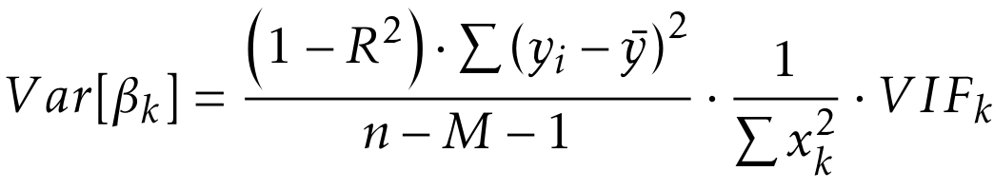
European Master of Science in Nuclear Fusion and Engineering Physics
VARIANCE INFLATION FACTOR
I_{p} [MA] | B_{t} [T] | …. | ϵ | τ_{E,th} [s]
0.2959 | 2.205 | …. | 0.242 | 0.051
…. | …. | …. | …. | ….
0.9794 | 4.795 | …. | 0.327 | 0.1731
0.3740 | 1.744 | …. | 0.286 | 0.0340
[D.Besley, E. Kuh, and R. Welsch, 2004]
[R. M. O’Brien, 2007]
Notes:
R squared: coefficient of determination

Slide 23
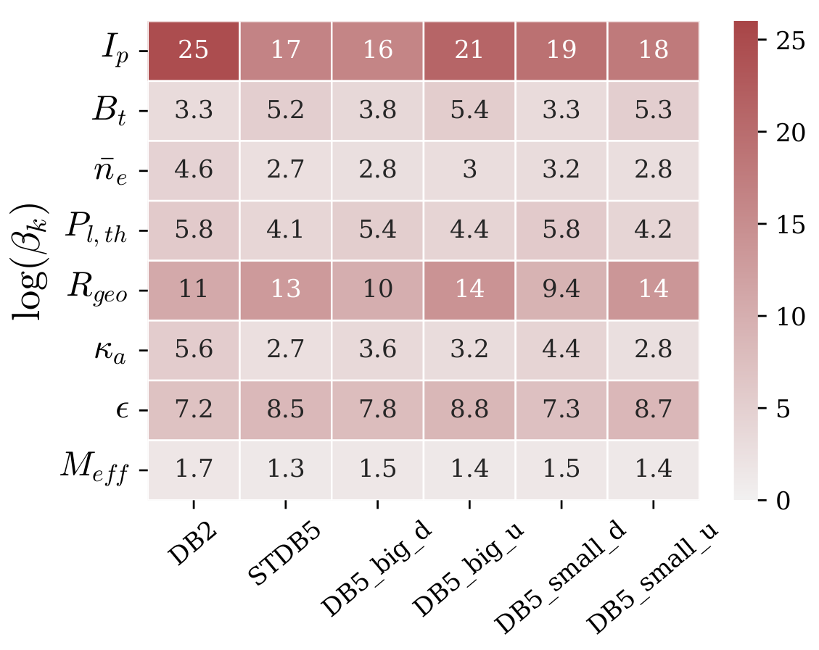
European Master of Science in Nuclear Fusion and Engineering Physics
VIF: RESULTS
Unaffecting - Big
Decreasing - Big
Decreasing - Small
Unaffecting - Small

Slide 24
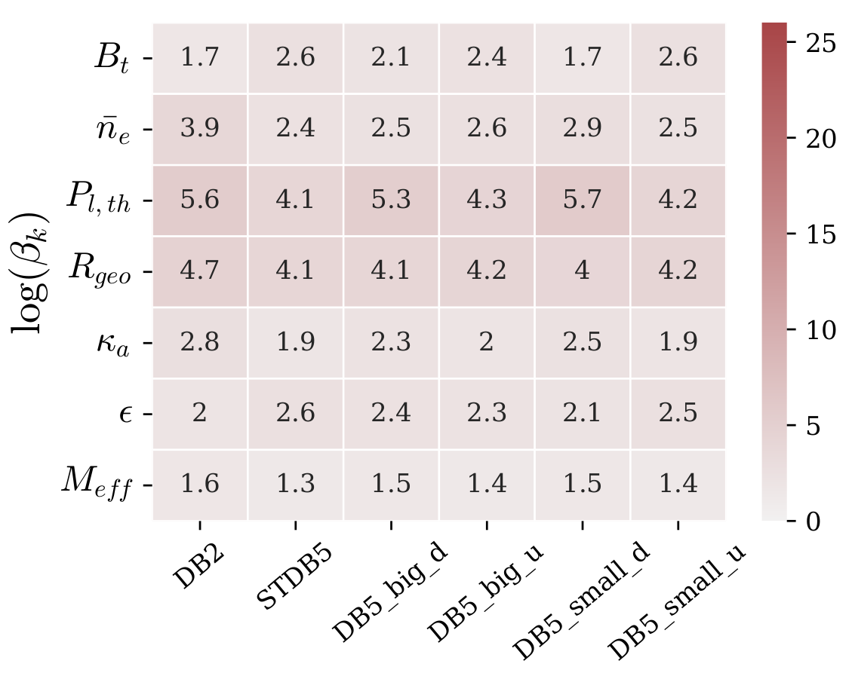
European Master of Science in Nuclear Fusion and Engineering Physics
VIF: RESULTS
Unaffecting - Big
Decreasing - Big
Decreasing - Small
Unaffecting - Small

Slide 25
European Master of Science in Nuclear Fusion and Engineering Physics
WORKFLOW
WHICH REGISTERS IN STDB5 ARE DECREASING α_{R}?
IS THIS DECREASE DUE TO
DATA ISSUES?
CAN WE PREDICT WHETHER A NEW REGISTER WILL DECREASE α_{R}?
RELATE THE FINDINGS TOKAMAK CHARs & PHYSICS
Depends on how you classify / label them.
Yes, but not entirely.
Notes:
title

Slide 26
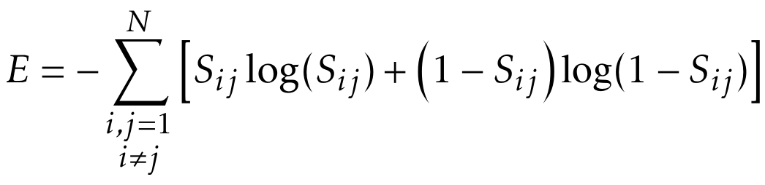
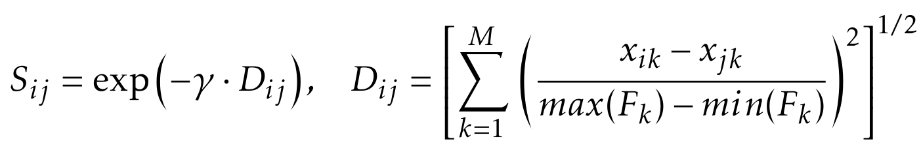
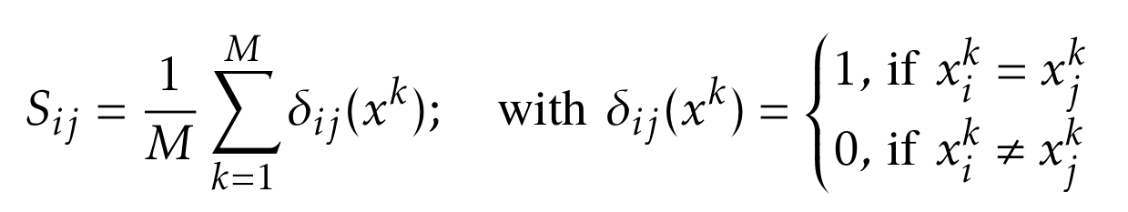
European Master of Science in Nuclear Fusion and Engineering Physics
47 columns
35 | 12
FEATURES OF INTEREST
: Entropy
IDEA
Keep features that increased the entropy when removed.
[M. Dash and H. Liu, 2020]
Notes:
Here, I explain why is it important to reduce the number of features in an algorithm.
“After careful consideration, at the end, a total of 47 features were considered to further investigation, based on my lecturios in this Master. Some of the features are related to NBI heating, the diomensionless form of the scaling law, and types of ELMs”.

Slide 27
European Master of Science in Nuclear Fusion and Engineering Physics
47 columns
35 | 12
FEATURES OF INTEREST
: Entropy + Low MCL
Removing features with high VIF and causing high condition indices.
MULTICOLLINEARITY
Notes:
Here, I explain why is it important to reduce the number of features in an algorithm.
“After careful consideration, at the end, a total of 47 features were considered to further investigation, based on my lecturios in this Master. Some of the features are related to NBI heating, the diomensionless form of the scaling law, and types of ELMs”.

Slide 28
European Master of Science in Nuclear Fusion and Engineering Physics
FEATURES OF INTEREST
: Entropy + Low MCL
FEATURE | DESCRIPTION | FEATURE | DESCRIPTION
BETA | Plasma pressure normalised to B_{t} | WFICFORM | Total fast ion energy due to ICRH estimated from approximate formula
RHOSTAR | Normalised Ion Gyroradius | WFFORM | Total fast ion energy due to NBI
NUSTAR | Normalised Ion collision frequency | ZEFFNEO | Line average plasma effective charge, from Bremsstrahlung
Q95 | Plasma safety factor at the 95% poloidal flux surface | DWDIA | Time rate of change of the total plasma stored energy
PFLOSS | NBI power that is lost from the plasma through charge exchange and unconfined orbits
Description of all columns in STDB5 found in [Princeton, 2021, http://arks.princeton.edu/ark:/88435/dsp01m900nx49h]

Slide 29
European Master of Science in Nuclear Fusion and Engineering Physics
FEATURES FOR PREDICTION
Best Performance with “big dataset”
Classifiers
Normalized Ion Gyroradius
GAUSSIAN PROCESS
Observations
FEATURE IMPORTANCE
ANALYSIS
Normalized Ion Collision Frequency
LABEL
FEATURES OF INTEREST
Safety Factor
Big / Small
RANDOM FOREST
Normalized Plasma Beta to B_{t}
Notes:
Here explai that you have different subset of features to analyse, this is due to the interference of one feature with another, so having the optimal subset is unknown.

Slide 30
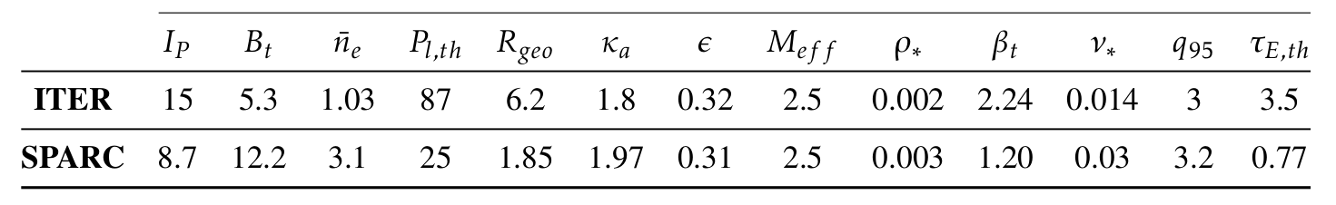
European Master of Science in Nuclear Fusion and Engineering Physics
PREDICTIONS IN NEW DEVICES
UNAFFECTED

Slide 31
European Master of Science in Nuclear Fusion and Engineering Physics
WORKFLOW
WHICH REGISTERS IN STDB5 ARE DECREASING α_{R}?
IS THIS DECREASE DUE TO
DATA ISSUES?
CAN WE PREDICT WHETHER A NEW REGISTER WILL DECREASE α_{R}?
RELATE THE FINDINGS TOKAMAK CHARs & PHYSICS
Depends on how you classify / label them.
Yes, but not entirely.
Yes, with only four variables.
Notes:
title

Slide 32
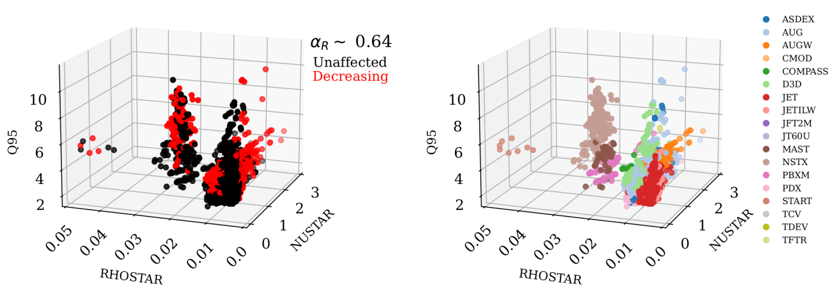
European Master of Science in Nuclear Fusion and Engineering Physics
Characteristic Clusters: main features
New STDB5
Notes:
“Do you remember that at the beginning of the presentation I mentioned about various ways on investigating the confinement time? Well one of them is with the dimensionless of the scaling law.

Slide 33
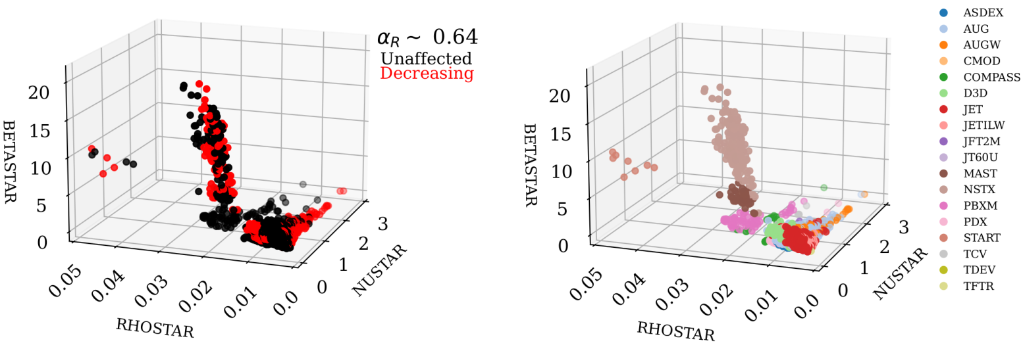
European Master of Science in Nuclear Fusion and Engineering Physics
Characteristic Clusters: main features
New STDB5
BETA
BETA
Notes:
“Do you remember that at the beginning of the presentation I mentioned about various ways on investigating the confinement time? Well one of them is with the dimensionless of the scaling law.

Slide 34
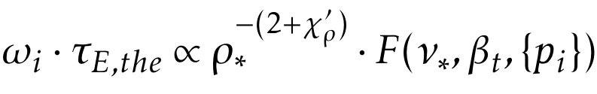
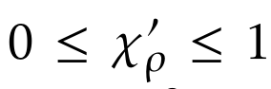
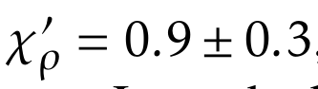
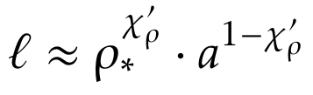
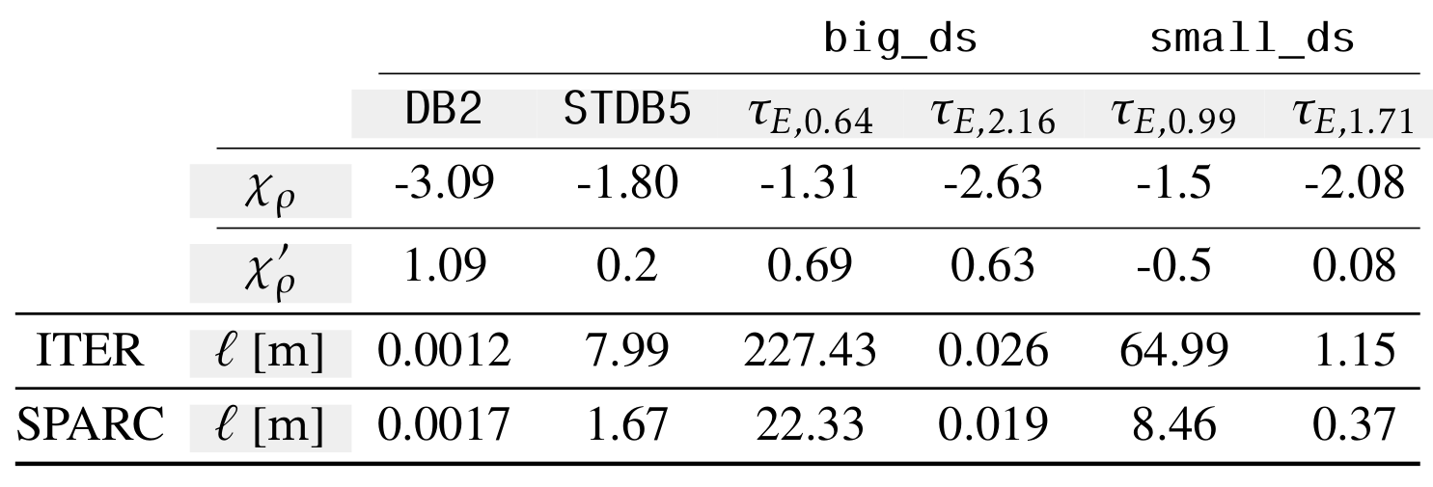
European Master of Science in Nuclear Fusion and Engineering Physics
Dimensionless Scaling and the Normalized Ion Gyroradius
with
H-mode
characteristic turbulence scale length
STDB2
STDB5
Decr.
Unaff.
Decr.
Unaff.
[G. Verdoolaege et al., 2021]
[I. P. E. G. et al., 1999]
Notes:
“Do you remember that at the beginning of the presentation I mentioned about various ways on investigating the confinement time? Well one of them is with the dimensionless of the scaling law.
DATASETS BEHAVE AS H-Mode Behaviour

Slide 35
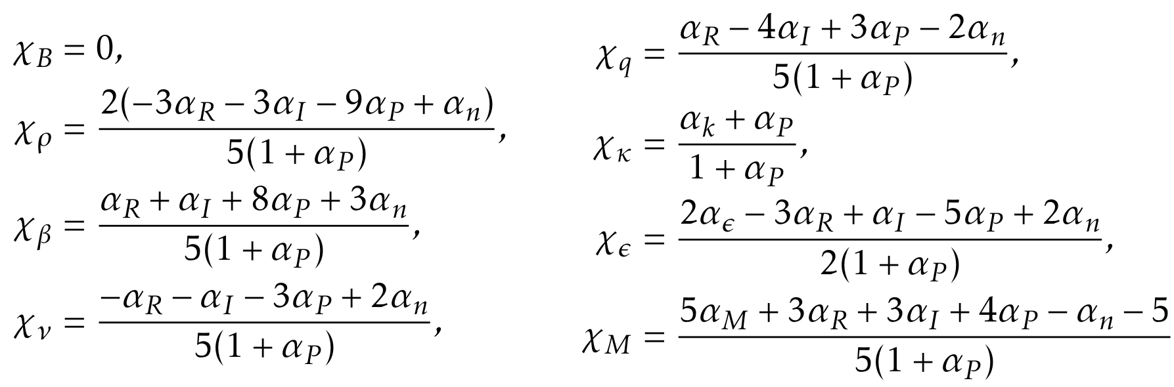
European Master of Science in Nuclear Fusion and Engineering Physics
Dimensionless Scaling and the Normalized Ion Gyroradius
[G. Verdoolaege et al., 2021]
[I. P. E. G. et al., 1999]
Notes:
Kadomtsev constraint || Connor and Taylor (a perpective on anomalous transport described by the Fokker-Planck equation) the Buckingham Π-Theorem, which
states that a function that expresses a physical law has the property of generalised homogeneity, meaning
that it does not depend on the units of measurement [15].

Slide 36
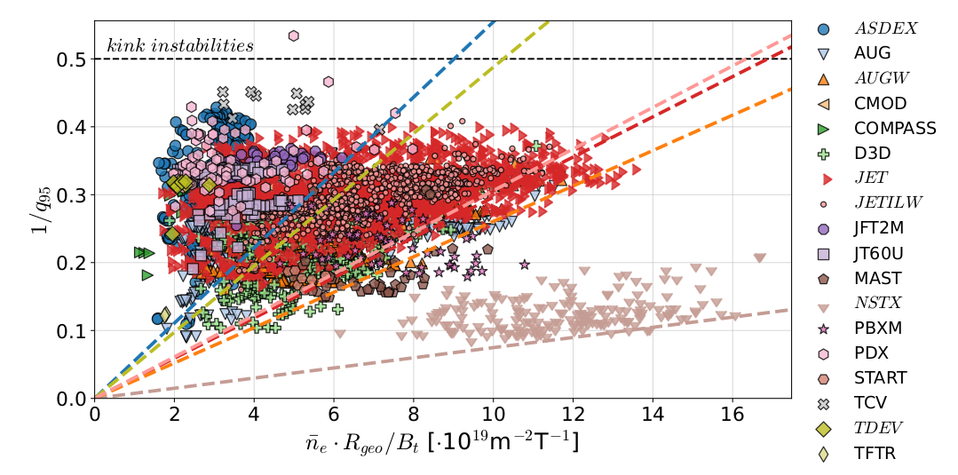
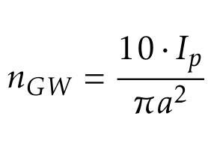
European Master of Science in Nuclear Fusion and Engineering Physics
DENSITY LIMIT
STDB5
Notes:
file:///home/kchinas/Documents/Universiteit/Thesis/kGitHub/FUSION-EP-Master-Thesis/Defence/HugillPlot_STDB5.html

Slide 37
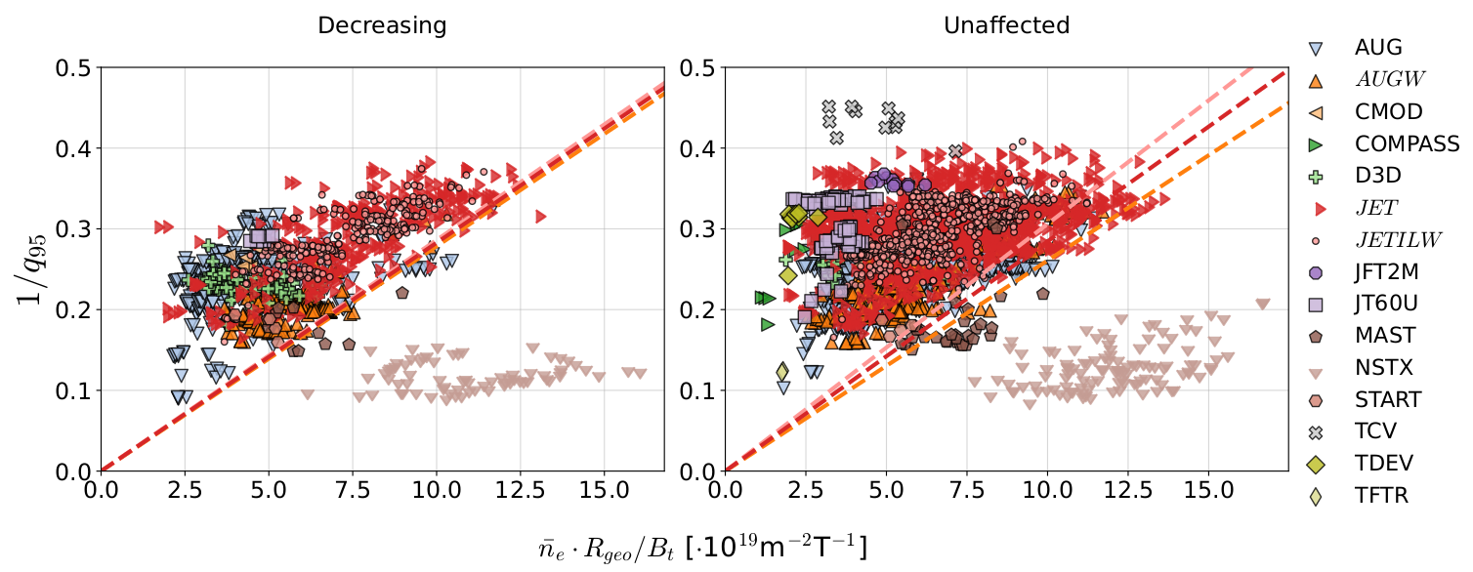
European Master of Science in Nuclear Fusion and Engineering Physics
DENSITY LIMIT
New STDB5

Slide 38
Conclusions
and Further Work
European Master of Science in Nuclear Fusion and Engineering Physics

Slide 39
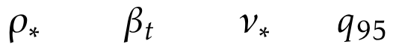
European Master of Science in Nuclear Fusion and Engineering Physics
CONCLUSIONS
FURTHER WORK
Multicollinearity is not the sole factor influencing α_{R}.
It is possible to predict influencing observations with .
Characteristic clusters for spherical tokamaks.
It is possible to tell if a dataset lacks of representative physics.
Most of the observations that surpassed the GW limit are classified as unaffecting.
ITER and SPARC are expected to follow a scaling law similar to the 1998 scaling (great news!).
Obtain more data on spherical tokamaks.
Discern between spherical and non spherical.
Take time-series data of relevant shots and subject to other ML algorithms; e.g. surrogate modelling.
Underlying Physics
Plasma Facing Components

Slide 40





Karina Chiñas Fuentes
Master of Science Student FUSION-EP Programme E karina.chinasfuentes@ugent.be
E nuclear.fusion@ugent.be L Sint Pietersnieuwstraat 41, 9000 Gent www.ugent.be
https://nuclearfusion.ugent.be/
European Master of Science in Nuclear Fusion and Engineering Physics
Universiteit Gent @ugent
@ugent Ghent University
Thank you! Questions?

Slide 41
Complete References
- Zohm, Hartmut. “Magnetohydrodynamic stability of tokamaks”. John Wiley & Sons, 2015.
- “Machine,” ITER, 2023. Available: https://www.iter.org/mach. [Accessed: Jul. 05, 2023] ‌
- W.-M Lee, “Statistics in Python — Collinearity and Multicollinearity”. Medium, 2021. [Online]. Available: https://towardsdatascience.com/statistics-in-python-collinearity-and-multicollinearity-4cc4dcd82b3f ‌
- D. Belsley, E. Kuh, and R. Welsch, “Regression Diagnostics”. Canada: Wiley-Interscience, 2004.
- R. M. O’Brien, “A caution regarding rules of thumb for variance inflation factors,” Qualitative & Quantitative, vol. 41, pp. 673–690, Oct. 2007, Published on March 13, 2007. doi: 10.1007/s11135-006-9018-6.
- G. Verdoolaege et al., “The updated ITPA global h-mode confinement database: Description and analysis,” Princeton Plasma Physics Laboratory, Princeton University, 2021. [Online]. Available: http://arks.princeton.edu/ark:/88435/dsp01m900nx49h.
- M. Dash and H. Liu, “Feature selection for clustering,” Arizona State University, Jun. 2020. [On- line]. Available: https://www.public.asu.edu/~huanliu/papers/pakdd00clu.pdf.
- G. Verdoolaege et al., “The updated ITPA global H-mode confinement database: Description and analysis,” Nuclear Fusion, vol. 61, May. 2021. doi: 10.1088/1741-4326/abdb91.
- I. P. E. G. on Confinement, Transport, I. P. E. G. on Confinement Modelling, Database, and I. P. B. Editors, “Chapter 2: Plasma confinement and transport,” Nuclear Fusion, vol. 39, no. 12, p. 2175, Dec. 1999. doi: 10.1088/0029-5515/39/12/302.
European Master of Science in Nuclear Fusion and Engineering Physics

